Slide 1
Resilience & wellbeing workshop

Slide 2
Before we start
Phones
Room rules
Pace
Action plans
Notes:
PILOT

Slide 3
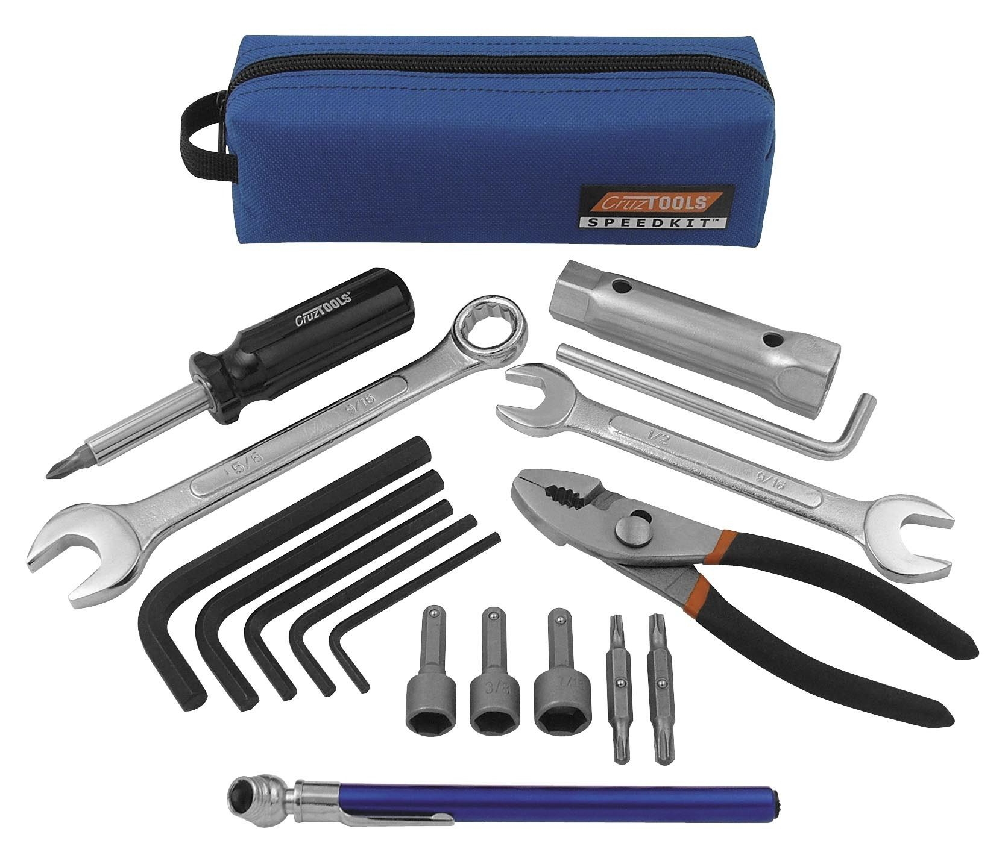

Slide 4
Course overview
The course will help you to:
Distinguish between stress and pressure
Recognise the early signs and symptoms of stress in yourself and others
Identify the factors associated with the job, organisation and individual that can cause stress and other mental health difficulties
Increase your own levels of resilience and wellbeing
Support each other at work to increase resilience and wellbeing across the Trust

Slide 5
Circle of Control
Circle of Concern
Circle of Influence
Circle of Control

Slide 6
Circle of Control
Circle of Concern
Circle of Influence
Circle of Control

Slide 7
It takes more than one sit-up to make a six-pack
Novak Djokovic

Slide 8
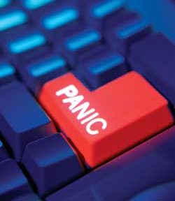
Activity
What is the definition of stress?
What’s the difference between stress and pressure?

Slide 9
Definition of Stress
The Health and Safety Executive define stress as “the adverse reaction people have to excessive pressures or other types of demand placed on them. It arises when they worry that they cannot cope.”
Pressure – resources are greater than demands
Stress – demands are greater than resources

Slide 10
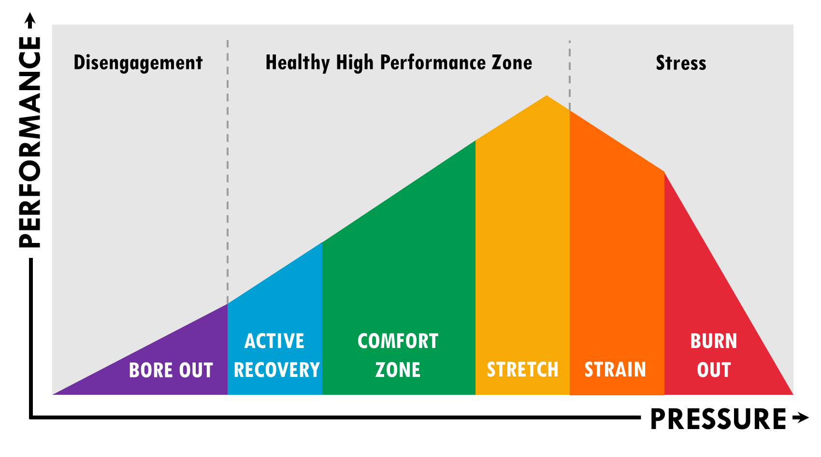
Pressure & Performance
Notes:
The pressure-performance curve is used as an analogy for the whole day. It describes where we want people to be – at the top of the curve.
Healthy high performance zone – this is the zone where people are experiencing a certain level of pressure, so they will feel challenged and stretched, but they can manage the pressure and generally find it motivating and engaging – bringing out the best in people. They will be feeling good and also performing at optimum levels. People need pressure that challenges and motivates them, but that they have the ability and support to deal with.
Strain/Burnout – this is where pressure has exceeded an individual’s ability to cope. The pressure is no longer manageable or motivating, it has turned into stress. This is where the health consequences and other negative consequences will be observed.
Bore out - this is where someone does not perceive themselves to be under very much work related pressure. Rust out does not necessarily mean that an individual has nothing to do – they may have a lot of work – however they are no longer finding it a challenge; they may be ‘going through the motions’. As a result they may lack motivation and disengage from their role and the organisation more broadly.
The challenge with the pressure-performance curve for managers is two-fold – not only do they need to understand where they are operating (and what they may need to do to ensure they are in the positive wellbeing zone most of the time) they also need to understand where the different staff they manage are operating and what they can do to ensure wherever possible that their staff are in optimal zone most of the time.
Reinforce the fact that individuals will respond differently to pressure and managers will need to recognise this and identify when different members of staff are potentially at risk of rusting out or burning out. What one member of staff will find challenging and motivating, could potentially be too much for another individual. Emphasise the need to balance challenge and support. The solutions for bore out and burn-out will really depend on the situation and the individual concerned, but will be related to the level of challenge and support that an individual experiences.
EX in WB where do they spend their time?

Slide 11
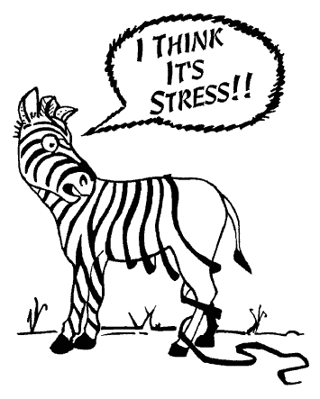
Activity
What are the signs and symptoms of stress?

Slide 12
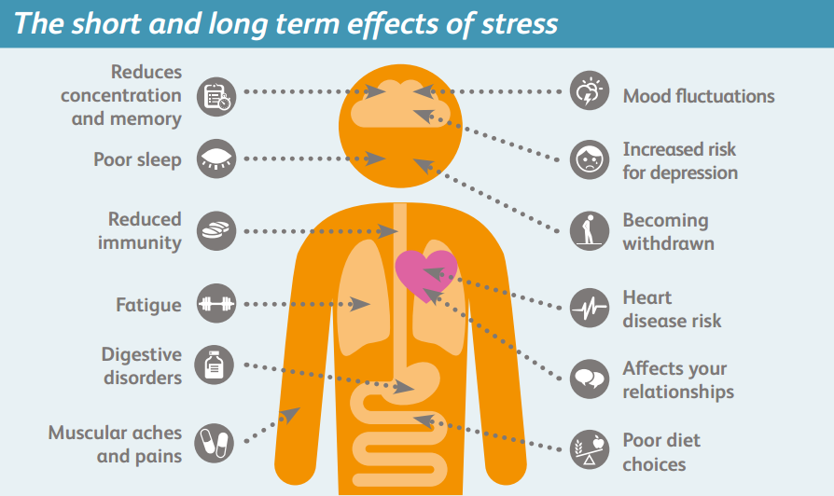
Notes:
Read through some of these effects of stress.
The basic premise of this slide is to convince people that mental wellbeing (stress) matters to them! There is an inherent link between psychological and physical health – it is important to look after both to stay well.
The biggest thing to note here for managers are changes in people. Know your employees and it makes it easier to spot when they are acting uncharacteristically.

Slide 13
Why does the body respond in this way?
Fight, flight or freeze?
Adrenalin increases
Heard rate increases and blood pressure rises
Muscles harden and tense, ready for action
Blood taken from digestion to muscles, increased acid in stomach
Breathing speeds up, heart rate increases

Slide 14
Understanding resilience and wellbeing

Slide 15
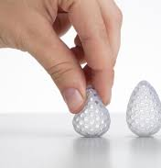
What is resilience?
‘The ability of a substance or object to spring back into shape; elasticity.’
‘The capacity to recover quickly from difficulties’
Oxford English Dictionary
‘The ability to bounce-back’
Other aspects of resilience include:
Becoming strong enough to live with uncertainty and ambiguity
Learning to grow, not crumble, through adversity.

Slide 16
The Trust’s new wellbeing policy

Slide 17
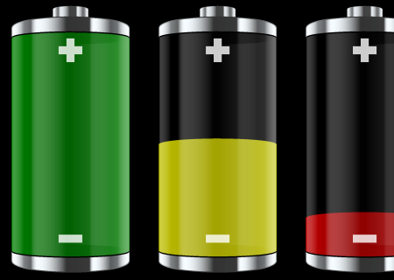
Your Energy Battery

Slide 18
Activity
‘Resilience is not just about how we endure,
it’s about how we recharge’
How do we recharge – during the day, after work, at weekends?

Slide 19
How do we recharge?
Time with friends & family
Laughter
Watching / taking part in sport
Exercise
Yoga / Pilates
Reading
Time on our own
Sleeping
Holidays
Time off / away
Doing different things
Being with friends
Meditation / mindfulness

Slide 20
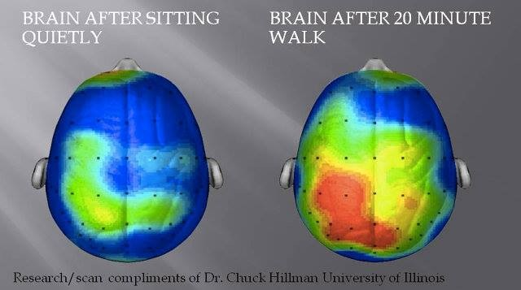
Brain after sitting quietly
Brain after 20 minute walk
How can you incorporate more movement into your life at home and / or work?

Slide 21
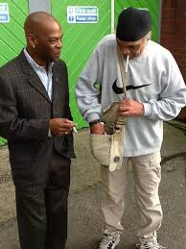
The Non-Fag Fag Break

Slide 22
Our support network
Who supports you?

Slide 23
Are you drinking enough?

Slide 24
Are you drinking enough?

Slide 25
Building emotional resilience Overcoming set backs and dealing with pressure

Slide 26
The Brain
Notes:
Talk about brain and logical vs emotional brain or slow vs fast brain. D Kahnemann work etc

Slide 27
the amygdala hijack
https://www.youtube.com/watch?feature=player_embedded&v=92G6qipTFYk
Notes:
7 minutes
PURPOSE: To understand the origins of impulsive, irrational or uncontrolled reactions that can occur in interactions.
RUN the activity (5 minutes):
Play the video (5.08 minutes).
DEBRIEF (2 minutes):
ASK: What’s the one thing Benjamin asks us to remember about his remarks? (That emotions drive behaviour, not the other way around.)
In a fight or flight situation, it is the amygdala that responds first, and it responds a hundred times faster than the thinking part of our brain. So it's important not to forget that we feel before we think. That's the way we've been hardwired—we can't ignore or deny this fact.
Equally importantly, the amygdala shuts down the thinking part of our brain (if a bear jumps out at us while we’re hiking, we don't stand there saying to ourselves, ‘I wonder what kind of bear that is?’). This is precisely what people are acknowledging when they say, ‘I was so angry I couldn't think.’
In conversations, there are no bears lurking ready to attack, yet people sometimes respond as if there were. Protecting your amygdala from being hijacked is a foundational emotional intelligence skill.
TRANSITION: I’m going to tell you a true story of an amygdala hijack.

Slide 28
Activity
What presses your buttons?
How do we manage our emotional response under pressure?

Slide 29
How do we manage our emotional response under pressure?
Breathe – low and deep
Count to 10
Pause / take a drink
Ask them questions
Trying to enable us / them to access the ‘thinking’ rather than ‘feeling’ parts of our brain

Slide 31
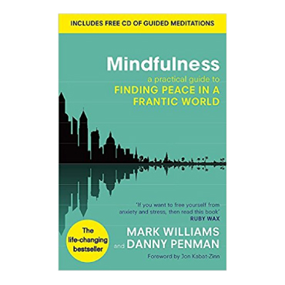
What do we mean by ‘Mindfulness’?
A mental state achieved by focusing one's awareness on the present moment, while calmly acknowledging and accepting one's feelings, thoughts, and bodily sensations.

Slide 32
Resilient thinking – ABC thinking
Activating event
Belief about event or adversity
Emotional consequences

Slide 33
FEAR
False
Evidence
Appearing
Real

Slide 34
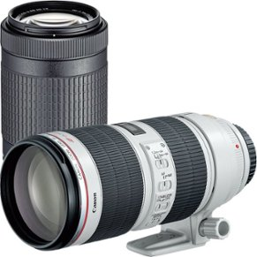
Different perspectives on the situation
Reverse lens
‘What would the other person in this situation say and in what ways might that be true?’
‘What would other people say about my response to the situation and in what ways might that be true?’
Long lens
‘How will I most likely view this situation in six months?’

Slide 36
Circle of Control
Circle of Concern
Circle of Influence
Circle of Control

Slide 37
Action plans
http://cambexec.co.uk/northants
Thank you!
kate@cambridgeexec.co.uk

